Slide 1
Big Mountain Resort
Problem Identification
Recommendation and key findings
Modeling results and analysis
Summary and conclusions
September 27,2020
Prepared by: Jessica Montealvo

Slide 2



Problem Statement
To assess the features and ticket prices of resorts in the same market segment as Big Mountain to establish a data driven business strategy which will maximize revenue while providing value to visitors.
Context: The current ticket price strategy relies on charging a premium above the average of resorts in the market segment. The business wants guidance on how to select a better value for their ticket price.
Criteria for success: A new ticket price will be proposed based on a market value model analysis.
Scope of solution space: Resorts within the market segment of Big Mountain were referenced for features and ticket price.
Constraints within solution space: Unknown operating costs and rate of facility utilization.
Stakeholders: Jimmy Blackburn (Director of Operations) and Alesha Eisen (Database Manager)

Slide 3
Recommendation and key findings
The data supports a ticket price increase up to $108.30, with an expected mean absolute error of $10.24, this means there is room to comfortably increase the price from $81.00 per adult.
Adding a run to increase the vertical drop by 150 feet and installing an additional chair lift, provides evidence that the ticket price can be increased by $3.00 which translates to $5,250,000 over the season.

Slide 4
Modeling results
Scenario 1: Close up to 10 of the least used runs Potential source to cut cost with closure of up to 5 runs
Closing 1 run makes no difference. Closing 2 and 3 reduces support for ticket revenue. Closing 4 or 5 runs is the same as closing 3 runs. Increasing the closures to 6 or more leads to a large drop in ticket price value and revenue.
Scenario 2: Add a run, increasing vertical drop by 150 feet, and installing an additional chair lift Recommended investment
This scenario increases support for ticket price by $3.00. Assuming 350,000 expected visitors, this translated to $5,250,000 over the season.
Scenario 3: Scenario 2 and adding 2 acres of snow making Not recommended
Such a small increase in the snow making area makes no difference.
Scenario 4: Increase the longest run by .2 miles and guaranteeing its snow coverage by adding 4 acres of snow making capability Not recommended
This scenario does not impact or make a difference in ticket price or revenue
The following scenarios were suggested as means to either cut costs or increase revenue (from ticket prices)

Slide 5
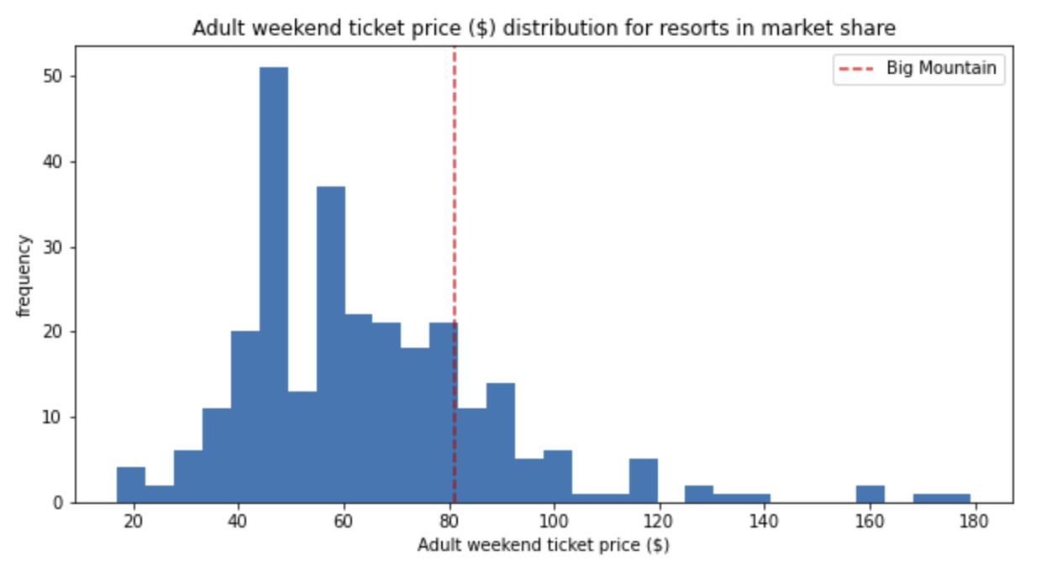
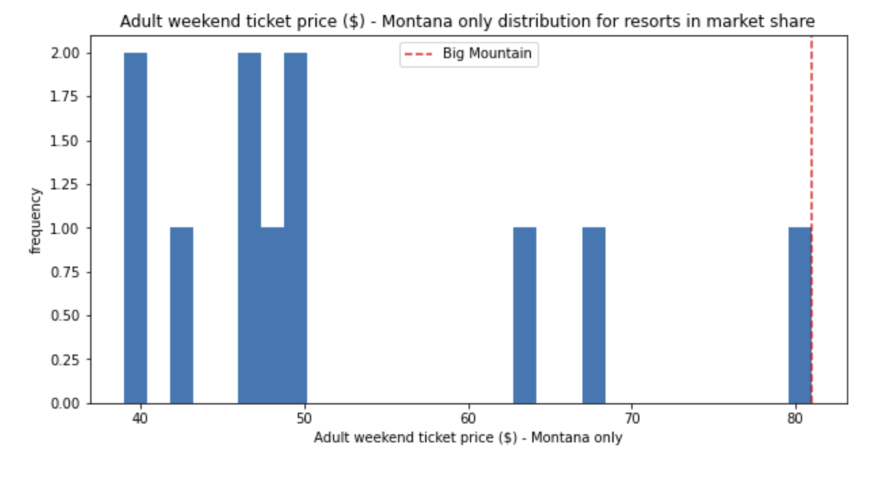
Price Analysis
Big Mountain sits mid-range amongst all resorts for price and at the top of the range for just other resorts in Montana

Slide 6
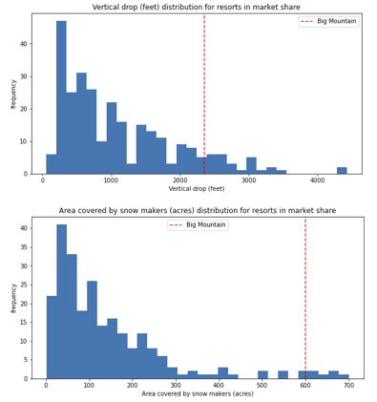
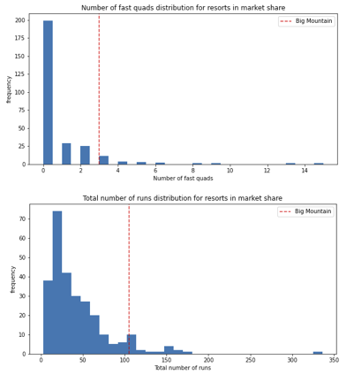
Feature Analysis
Features that came up as important in the modeling, not just the final model included:
fastQuads
Runs
Snow Making_ac
Vertical_drop
Big Mountain ranks high in all

Slide 7
Summary and conclusion
The resort’s pricing strategy can now rely on a data-driven business strategy that substantiates a better value for their ticket price. The market analysis supports increasing the adult daily ticket price to up to $108.30. Furthermore, there is data to support closing up to 5 runs to cut costs and adding a run to increase the vertical drop by 150 feet as well as adding a new chair lift, which supports an increase of $3 dollars to the ticket price.

